Slide 1
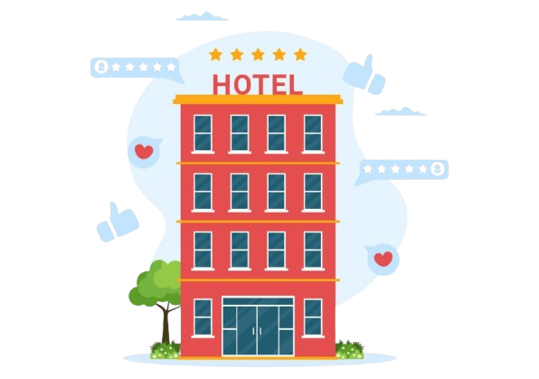


HOSPITALITY ANALYSIS
ATLIQ GRANDS
Notes:
Hie all i am Srishti a Data Analyst, today i will be presenting my Project on Hosptality Analysis that i have created during my journey with Codebasics bootcamp 3.o..So without any further delay let's go ahead and explore it.

Slide 2

AGENDA
COMPANY OVERVIEW
BUSINESS MODEL
PROBLEM STATEMENT
UNDERSTANDING IMPORTANT BUSINESS TERMS
REVENUE REALIZED VS REVENUE GENERATED
DASHBOARD
INSIGHTS AND RECOMMENDATION
Notes:
Before we dive into the project, I’d like to outline what we’ll be covering today.
First, I’ll provide an overview of the company, giving you a clear context. Next, we’ll discuss the company’s business model to understand how it operates.
Following that, we’ll address the problem statement that we’re aiming to solve. To facilitate our discussion, I’ll introduce key business terms related to the hospitality domain, which will help us better grasp the project’s details.
Then, I’ll showcase the dashboard I’ve created, which visualizes our findings. Finally, we’ll explore the insights and recommendations that emerged from analyzing the provided data.
Let’s get started!”

Slide 3

COMPANY OVERVIEW
AtliQ Grands is a prominent name in India’s hospitality industry, renowned for its chain of five-star hotels located in key cities such as Bangalore, Delhi, Mumbai, and Hyderabad. Catering to both business and luxury travelers, each property provides a diverse range of room options designed to meet the varied needs of its guests.
ATLIQ GRANDS
Notes:
AtliQ Grands is a leading name in India’s hospitality sector,

Slide 4
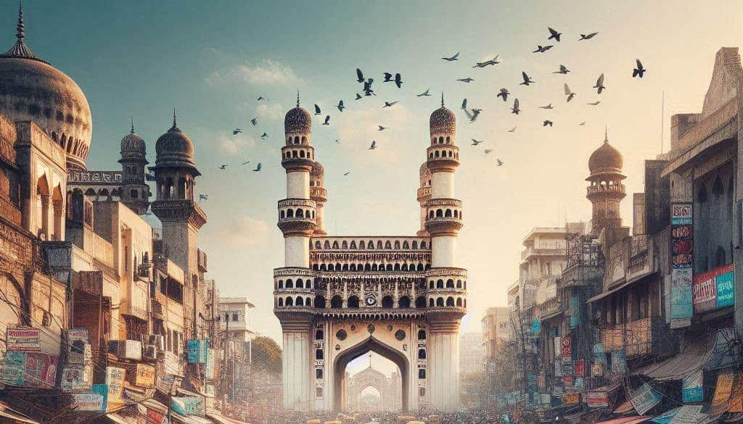

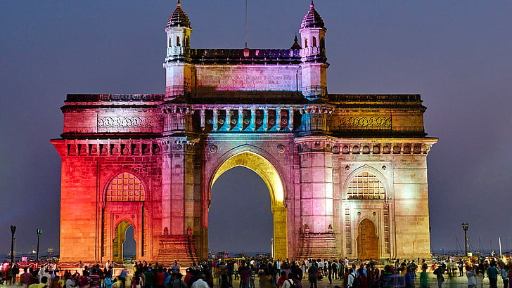

ATLIQ GRANDS
HYDERABAD
DELHI
MUMBAI
BANGALORE
Notes:
AtliQ Grands it is known for its chain of five-star hotels in major cities like Bangalore, Delhi, Mumbai, and Hyderabad.

Slide 5

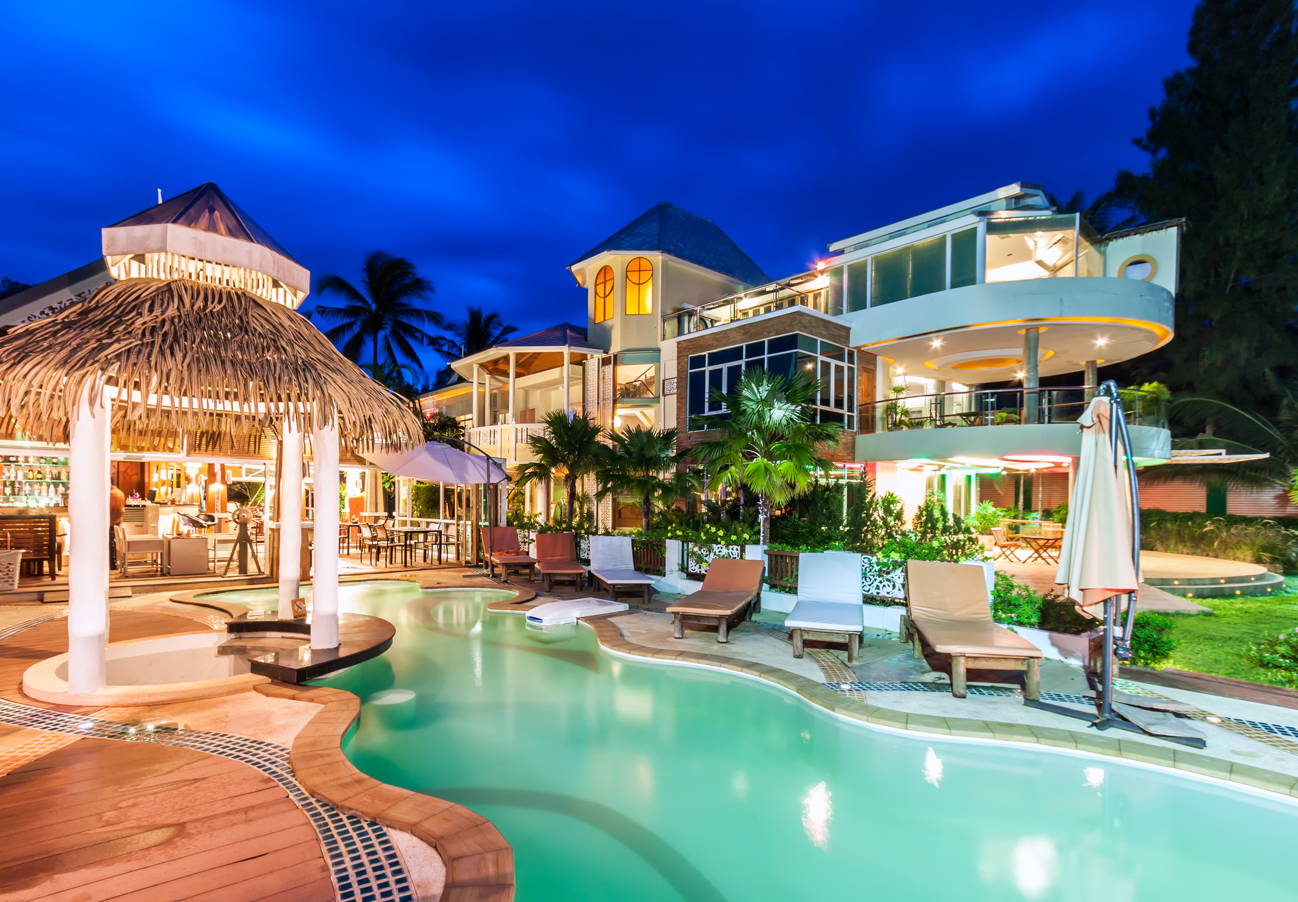
ATLIQ GRANDS
BUSINESS HOTEL
LUXURY HOTEL
Notes:
This chain of hotel Caters to both business and luxury travelers,

Slide 6
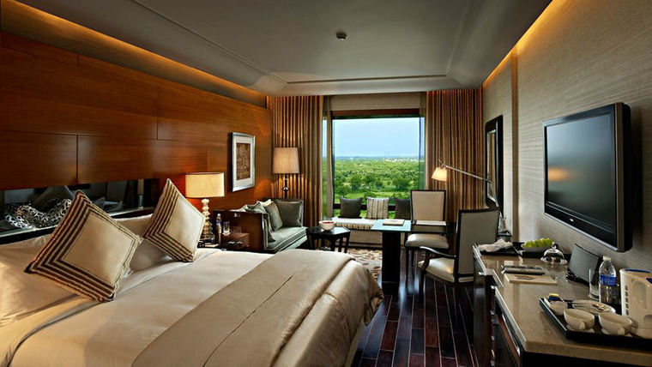
ATLIQ GRANDS
ROOM CLASS
ELITE
PRESIDENTIAL
PREMIUM
STANDARD
Notes:
each hotel offers a variety of room options ie. elite, presedential, premium and standard rooms, tailored to meet the diverse needs of its guests.”

Slide 7


PROBLEM STATEMENT
AtliQ Grands, a renowned player in India’s luxury and business hotel industry for over two decades, is currently facing a significant challenge. Despite their longstanding presence, they are experiencing a decline in both market share and revenue, driven by increasing competition and internal management decisions. To reverse this trend, they aim to leverage business and data intelligence. Without an in-house team, AtliQ Grands plans to hire a third-party service provider to gain insights from their historical data and drive informed strategies.
Notes:
now let us understand the problem statement AtliQ Grands, a well-established hotel chain in India’s luxury and business hotel industry for over 20 years, is currently facing a tough challenge. Despite their long-standing presence, they are losing both market share and revenue. This decline is mainly due to increasing competition and some internal management decisions. To address this, AtliQ Grands is turning to business and data intelligence to make smarter decisions. Since they don’t have their own team for this, they’ve decided to bring in an external service provider to analyze their past data and provide actionable insights. As a data analyst, I’ve taken on this task to help AtliQ Grands identify key trends, improve decision-making, and ultimately regain their competitive edge.

Slide 8
UNDERSTANDING IMPORTANT TERMS
Revenue: Total revenue realized from bookings.
Total Bookings: Count of total bookings made across all hotels.
Total Capacity: Total number of rooms available across all hotels.
Total Successful Bookings: Total number of successful bookings.
Occupancy %: Percentage of rooms occupied compared to the total capacity.
Average Rating: Average customer rating for the hotels.
No. of Days: Total number of days for which data is available.
Total Cancelled Bookings: Total number of cancelled bookings.
Cancellation %: Percentage of bookings that were cancelled.
Total Checked Out: Total number of successful check-outs.
Total No Show Bookings: Total bookings where customers did not show up.
No Show Rate %: Percentage of no-show bookings relative to the total bookings.
Booking % by Platform: Distribution of bookings across different booking platforms.
Notes:
lets understand few important metrics that will help us to analyze and understant the project in detail
Revenue: This is the total amount of money earned from all hotel bookings. It includes income from room charges and other services like dining or spa.
Total Bookings: This refers to the total number of reservations made at all the hotels combined, whether they were completed or not.
Total Capacity:refers to The total number of rooms available in all hotels, including those that are booked and those that are empty.
Total Successful Bookings: This is the number of bookings that were completed, meaning customers actually stayed in the rooms they reserved.
Occupancy %: This shows how many rooms were occupied compared to the total number of rooms available. It’s a key metric to understand how full the hotels are.
Average Rating: This is the average customer rating given to the hotels, usually on a scale of 1 to 5. It helps to gauge overall customer satisfaction.
No. of Days: This simply refers to the total period for which the data is available and analyzed, whether it’s a week, month, or year.
Total Cancelled Bookings: This counts how many bookings were cancelled by customers before their stay.
Cancellation %: This shows the percentage of bookings that were cancelled compared to the total bookings made.
Total Checked Out: The number of guests who successfully completed their stay and checked out of the hotel.
Total No Show Bookings: This counts the bookings where customers made a reservation but never showed up for their stay.
No Show Rate %: This shows the percentage of no-show bookings compared to the total bookings. A high rate could indicate issues with the booking process or customer commitment.'
Booking % by Platform: This breaks down how many bookings were made through different booking platforms (like hotel websites, travel apps, or third-party websites). It helps understand where most customers are booking from.

Slide 9
Booking % by Room Class: Distribution of bookings across various room classes (Standard, Elite, Premium, etc.).
ADR (Average Daily Rate): Average revenue generated per room sold.
Realization %: Percentage of successful check-outs from total bookings.
RevPAR (Revenue Per Available Room): Average revenue generated per available room, regardless of occupancy.
DBRN (Daily Booked Room Nights): Average number of rooms booked per day over the given period.
DSRN (Daily Sellable Room Nights): Average number of rooms ready for sale per day.
DURN (Daily Utilized Room Nights): Average number of rooms actually utilized by customers per day.
Revenue WoW Change %: Week-over-week percentage change in revenue.
Occupancy WoW Change %: Week-over-week percentage change in occupancy rate.
ADR WoW Change %: Week-over-week percentage change in average daily rate.
RevPAR WoW Change %: Week-over-week percentage change in revenue per available room.
Realization WoW Change %: Week-over-week percentage change in the realization rate.
DSRN WoW Change %: Week-over-week percentage change in sellable room nights.
Notes:
Booking % by Room Class: shows how bookings are distributed across different types of rooms, such as Standard, Elite, or Premium. It helps us understand which room types are more popular.
ADR (Average Daily Rate): This is the average revenue earned from each room sold per day. It tells us how much, on average, guests are paying for rooms.
Realization %: shows the percentage of bookings that resulted in successful check-outs. It helps us measure how many bookings were fully completed without cancellations or no-shows.
RevPAR (Revenue Per Available Room): measures how much revenue is generated per room, whether it’s booked or not. It’s a key metric for understanding overall room performance.
DBRN (Daily Booked Room Nights): This is the average number of rooms booked each day over a specific period. It helps us track daily booking activity.
DSRN (Daily Sellable Room Nights): This tells us the average number of rooms that were available for sale each day. It shows how many rooms were ready for guests.
DURN (Daily Utilized Room Nights): This is the average number of rooms that were actually occupied by guests each day. It helps us track how much of the hotel’s capacity was used.
Revenue WoW Change %: This shows how much the revenue has increased or decreased compared to the previous week. It helps us monitor week-to-week growth or decline.
Occupancy WoW Change %: This measures how much the occupancy rate has changed compared to the previous week, helping us track whether more or fewer rooms are being filled.
ADR WoW Change %: This shows the week-to-week change in the average daily rate, helping us track if guests are paying more or less for rooms compared to last week.
RevPAR WoW Change %: This shows the week-over-week change in revenue per available room. It indicates whether overall room revenue is increasing or decreasing compared to the previous week.
Realization WoW Change %: This shows how the realization rate (successful check-outs) has changed compared to the previous week, helping us track trends in completed bookings.
DSRN WoW Change %: This tracks how the number of sellable rooms has changed week-over-week. It helps us understand whether more or fewer rooms are available for guests compared to the previous week.

Slide 10
REVENUE REALIZED VS REVENUE GENERATED
1. Revenue Realized:
Definition: This refers to the revenue that has been actually collected by the business. It means the money has been received for services or products provided. In the context of hotels, revenue realized would be the amount of money the hotel has received after the guest has checked out and paid.
Example: If a guest books a room and stays for three nights, the money collected at checkout is the revenue realized.
2. Revenue Generated:
Definition: This is the total potential revenue from all bookings or sales made, regardless of whether the payment has been received or not. For a hotel, revenue generated would include the bookings that are made but may not have been paid for yet (e.g., future bookings or bookings where payments are pending).
Example: If a guest makes a booking but hasn't stayed yet, the total amount expected from that booking would be considered revenue generated.
Notes:
moving ahead we also need to understand the difference between revenue realized and revenue generated
Revenue Realized:
is the money the business has actually received. In hotels, it refers to the amount collected after a guest has checked out and paid for their stay
for Example: If a guest stays for three nights and pays when they check out, the payment made at checkout is the revenue realized.
now Revenue Generated:
refers to the total potential income from all bookings or sales, whether the payment has been received or not. In hotels, it includes bookings that are made but may still be unpaid, like future reservations or those with pending payments.
Example: If a guest books a room for a future date but hasn’t paid yet, the total amount expected from that booking is considered revenue generated.

Slide 11
INSIGHTS
Mumbai leads in revenue generation among all cities, with an impressive total of around ₹661 million, including both weekdays and weekends.
Delhi, despite achieving the highest average rating, registered the lowest revenue at around ₹291 million.
A significant portion of revenue comes from luxury hotels, contributing 62.17% to the overall revenue.
MakeMyTrip recorded the second-highest number of bookings across all booking platforms, showing its popularity among customers.
Weekends contribute to higher revenue, contributing total of 1.16 billion rupees.
Among all Room Class Elite and Premium are the highest revenue generator.
Notes:
now lets look at the insights that i have drawn after anlysing the data insights from the data analysis:
Mumbai generated the highest revenue among all cities, totaling around ₹661 million, including both weekdays and weekends.
Even though Delhi has the highest average customer rating, it recorded the lowest revenue at approximately ₹291 million.
A large portion of the total revenue comes from luxury hotels, which contribute 62.17% of the overall earnings.
MakeMyTrip was the second-most popular booking platform, showing a strong customer preference for this platform.
Revenue is significantly higher on weekends, contributing ₹1.16 billion in total.
Rooms in the Elite and Premium categories are the top revenue generators among all room classes.

Slide 12
Delhi has high average rating but its revenue lags. To address this, it's recommended to implement targeted marketing campaigns to attract more visitors and optimize pricing strategies to boost overall revenue.
Despite sharing similar average ratings with other room classes, Presidential and Standard rooms generate lower revenue. To address this, it's recommended to review pricing strategies and focus on enhancing the customer experience to optimize revenue from these room types.
Bangalore's revenue is strong, but its average rating is quite low. To improve this, focus on enhancing customer experience and service quality. Implementing facility upgrades and a robust feedback mechanism will help boost overall satisfaction.
Despite having similar average ratings, business hotels are generating less revenue than luxury hotels. To address this, it’s essential to upgrade amenities, improve service quality, and implement targeted changes to enhance the overall guest experience at business hotels. These adjustments could help bridge the revenue gap.
RECOMMENDATIONS
Notes:
now these are my recommendations :
Even though Delhi has a good customer rating, its revenue is falling behind. To fix this, we should focus on targeted marketing campaigns to attract more visitors and adjust pricing strategies to increase revenue.
Presidential and Standard rooms are underperforming: These rooms, despite similar ratings to other room classes, are generating lower revenue. The solution is to review pricing and focus on improving the guest experience for these specific room types to boost their performance.
Bangalore is making good money, but customer ratings are lower. To improve this, we need to focus on upgrading facilities, enhancing the guest experience, and setting up a strong feedback system to raise satisfaction levels.
Business hotels, even with similar ratings to luxury hotels, generate less revenue. To address this, it's important to upgrade amenities, improve service quality, and make targeted changes to improve the overall guest experience. These improvements will help close the revenue gap.

Slide 13
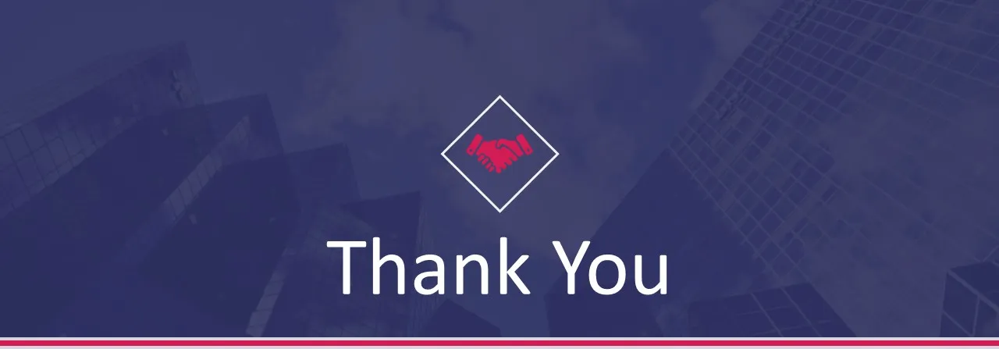



Contact Number 7463977924
Email Address Srishti.datas@gmail.com
Notes:
this project gave us some great insights into how the hotel industry is performing and showed areas where things can be improved. I believe these data-driven recommendations will help AtliQ Grands make even better business decisions going forward. I want to give a big thanks to the Codebasics team and AtliQ Grands for letting me work on this project – it’s been an amazing learning experience, and I’m really grateful for the trust you’ve shown in me. And lastly, a huge thank you to all of you for taking the time to listen and engage with my presentation. Your support means a lot!"

